Slide 1
Advanced Control Design for Optimal Operation and Maintenance of Wind Turbines
PhD Prospectus, June 2017
PhD student: Yuan Yuan
Major Advisor: Professor Jiong Tang
Associate Advisors: Professor Chengyu Cao
Professor Xu Chen
Professor Richard Christenson
Professor Horea Ilies
Dynamics, Sensing, and Controls Laboratory
Notes:
Good morning everyone; my name is Yuan Yuan, The title of my presentation is …
1

Slide 2
Outline
Background
Research Objective
Proposed Adaptive Control Method
Concluding Remarks
Future Tasks
Notes:
This is an outline of my presentation, first, background

Slide 3
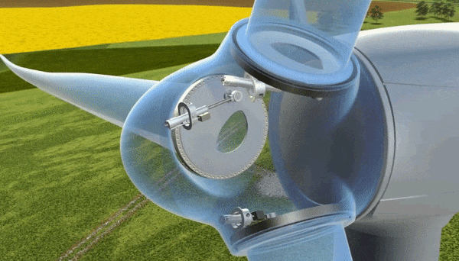
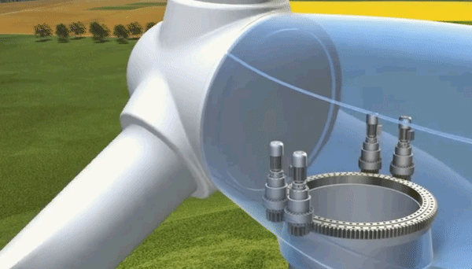
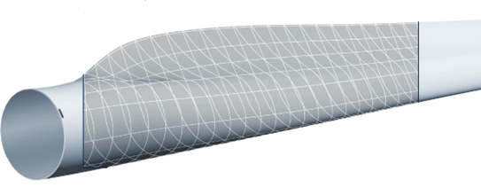
Background: Wind Turbine and Control
Wind Energy
Fastest growing renewable energy source in the world: The worldwide wind capacity reached over 400,000 MW by the end of 2015
Low cost & environmentally friendly
Pitch control animation
Wind turbine control loops
Generator torque control
Blade pitch control
Nacelle yaw control
Source: Liebherr
Yaw control animation
Notes:
It is well known that wind energy is the fastest ….
It is also low cost
One important aspect of wind turbine is the control system. Let us look at the control mechanism of a typical wind turbine
The blade has a lot of airfoil cross-sections consisting of different sizes and shapes from the root to tip, the simple airfoil technology makes the wind turbine blade turn, a lift force is produced when a fluid moves over an airfoil.
The wind turbine blades typically turn at a very low speed due to the noise and mechanical strength, considering this low speed rotation we canot produce any meaning electricity frequency from the generator. So before connecting to the generator, the speed is increased in a gearbox.
There are 3 separate loops here. The first one is ….
In this research I focus on … which are most commonly studied in high wind speeds
//generator change the frequncey
Hydraulic pitch torque control: applying torque on the generator
Yaw: wind turbine be alligened with the wind direction

Slide 4
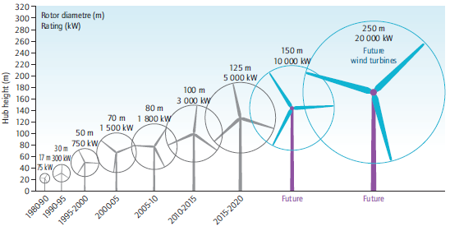


Challenges of Wind Turbines
Source: DOE
Goal: to reduce the cost of wind energy
Complex dynamics
Increased turbine size
Complex structures: airfoil-shaped blades
Uncertain environments
Time-varying wind speeds
Weather changes, icing, and assemblage error of turbine
Advanced controllers can help reduce maintenance cost and increase power capture
Notes:
In practice, our final goal is to reduce….
However, There are some major challenges
The first one is the complex .. Because of …. Such as..
The size of wind turbines have been progressively larger over the past 30 years. And the blade structure have been more complex. They can increase generation capacity and drive down costs. However, they also lead to more frequent maintenance.
The other chan.. Comes form ,..both in operating conditions and system properties. The sytem can be influenced..
The uncertain ..will affect the power capture..

Slide 5
Outline
Background
Research Objective
Proposed Adaptive Control Method
Concluding Remarks
Future Tasks

Slide 6
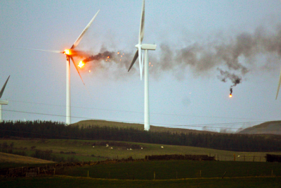
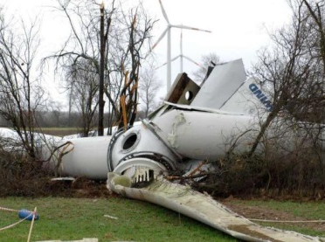
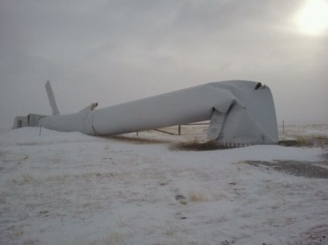
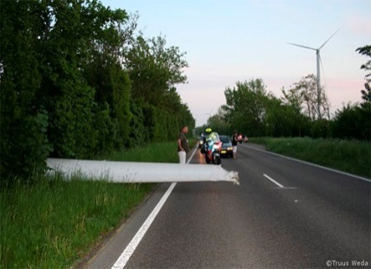
Research Objective
Different control goals
Speed control
Power control
Load reduction on components
Prolonged actuator life
Complex dynamics & uncertain environments
Conflicting objectives
We need to balance all the objectives together
Notes:
To reduce the overall cost, we have several…first we need the speed control to keep the rotor at the rated value when wind speed is very high. If the rotor is over-speed, it will cause the over-heat of the generator and make the turbine on fire as shown in the first figure.
Also we want the power control, to make sure we capture the maximum power from wind
In addition, we can see there are a lot of components failure, the tower may fall and blade may crack. We need to reduce the loads.
Also, the life of actuators has its limit, changing them too often will increase more costs. So that we need to prolong the actuator life.
However,…..it is quite challenging when we realize multiple objectives under comlex ….
Because these objectives maybe conflicting with each oter..

Slide 7
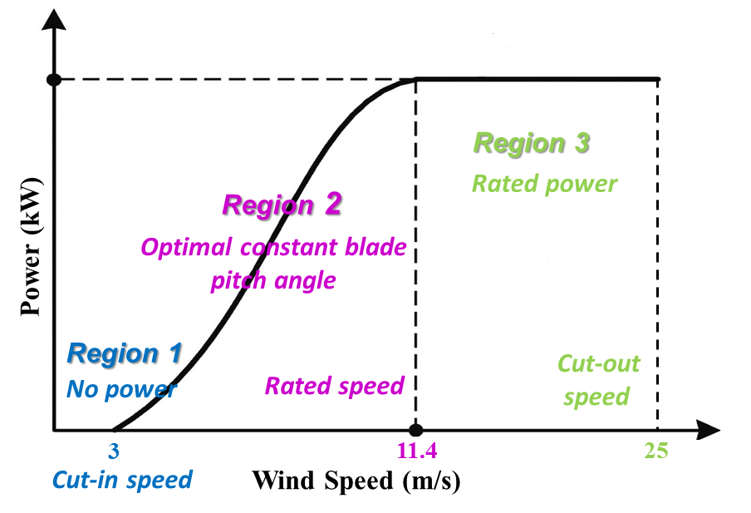
Research Objective
Optimal balance between energy production performance and reliability of components
Region 3: pitch control
Maintain the rated generator speed
Mitigate structural loads
Control laws
Baseline PID control ^{[1]}
Disturbance accommodating control
Adaptive control (to be explained)
Incorporating disturbance accommodation
Region 2: torque control^{[1]}
Maximum power
[1] Jonkman et al., National Renewable Energy Laboratory Technical Report, 2009.
Notes:
So the research objective is to …
Wind operating conditions are traditionally divided into 3 regions
This figure shows the operating regions…
In Region 1, the wind speed is very low, turbine did not start, there is no power.
In Region 2, we want to get maximum power…Blade pitch angle is held optimal constant. and the torque control is used to capture the maximum power, since the wind speed is low in this region, we do not consider load mitigation in this region.
In Region 3 high, we will make the torque to be constant, and use pitch control to maintain the rated generator speed in order to have rated power. And meanwhile to mitigate…
So in this research, we mainly study the pitch control which happened in region 3.
Here in this research we will use… to tackle with the uncertain environments.

Slide 8
Outline
Background
Research Objective
Proposed Adaptive Control Method
Concluding Remarks
Future Tasks

Slide 9
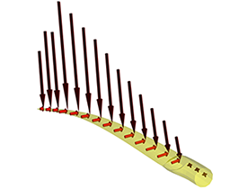
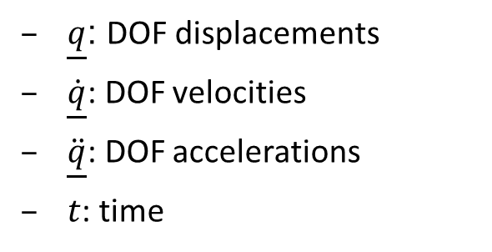
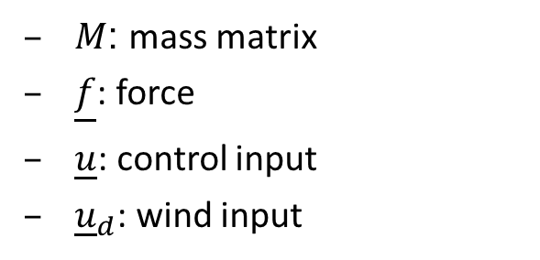
Nonlinear Aerodynamics
AeroDyn
An aero-elastic simulation code (by NREL) to predict the aerodynamics
Input: steady or turbulent wind file
Output: force and moment on the turbine components
Nonlinear aero-elastic equations of motion of wind turbine system
$M$: mass matrix
$\underline{f}$: force
$\underline{u}$: control input
${\underline{u}}_{d}$: wind input
$\underline{q}$: DOF displacements
$\underline{\dot{q}}$: DOF velocities
$\ddot{\underline{q}}$: DOF accelerations
$t$: time
Notes:
In order to get a proper model to design the controller,
we use the AeroDyn code to….. The input are wind file, turbine geometry, airfoil files and so on.
The output is force ……
The nonlinear …..is in this from. q .. F.. U.. Ud..
M is mass matrix, it is related to q, u, t that is because of different coordinates we use.
//which is independent, wind speed, pitch angle
which is not: rotor speed

Slide 10
Model Linearization
FAST (Fatigue, Aerodynamics, Structures, Turbulence)
FAST code (by NREL) used for simulating the coupled dynamic responses of wind turbines
State space representation
Numerically linearize the equation by perturbing (∆) each variable about their respective operating points (op):
linearization
Notes:
Then we can link it to FAST code to do linearization
FAST numerically …and substituting it to the previous nonlinear equation of motion
after Taylor series expansion. We could get the standard linearized form
And this is the state space form, delta ud is disturbance from the wind speed at operating point
So we have got the linearized model
(DspCis the displacement output matrix VelCis the velocity output matrix)

Slide 11
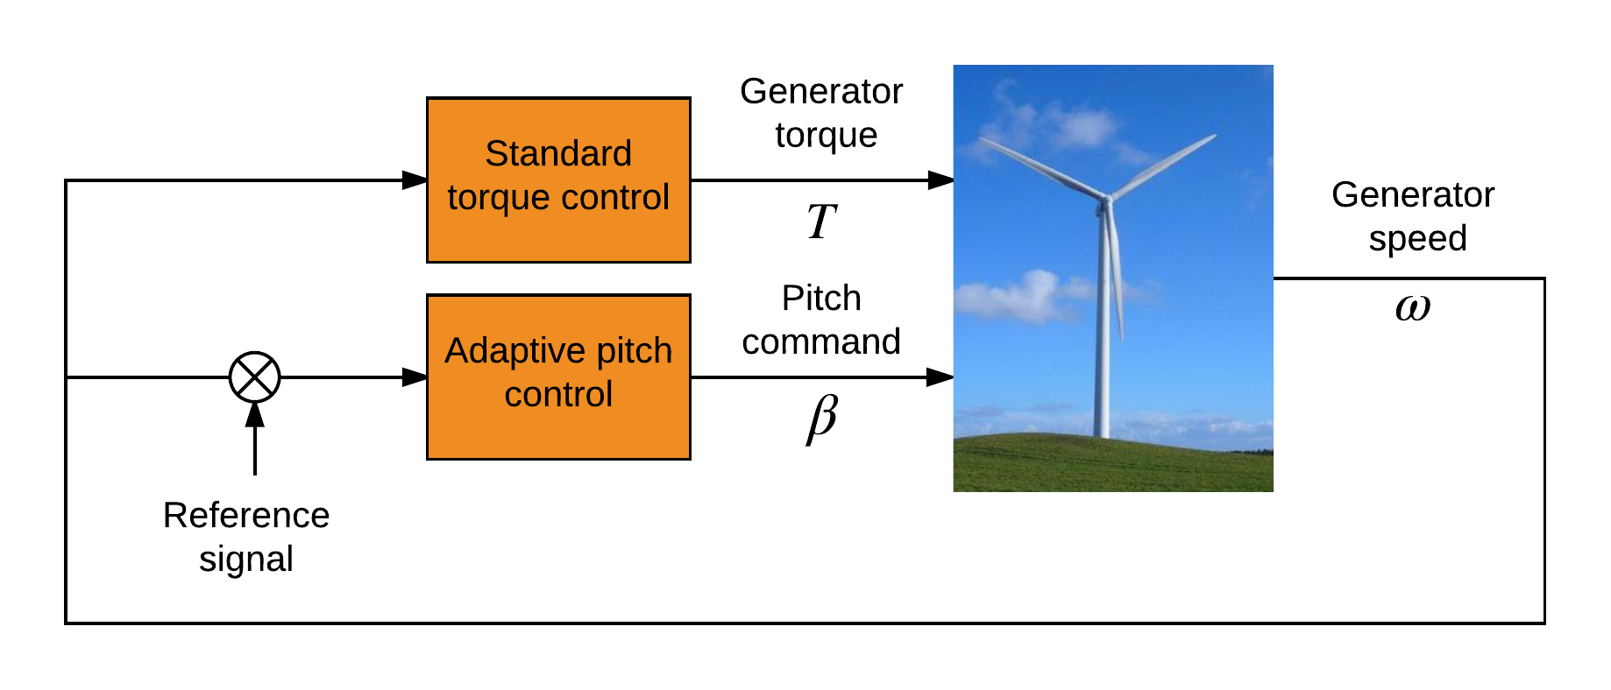
Control Architecture
-
Torque control: Standard torque control
Pitch control: Adaptive control
Yaw control: Not involved
Notes:
In this analysis, The yaw control is not involved, similar to other studies. We assume wind turbine has faced to the wind direction
The output of the pitch controller is the pitch command, we need to mention , it is a collective control signal, which means all the blades will pitch at the same angle

Slide 12
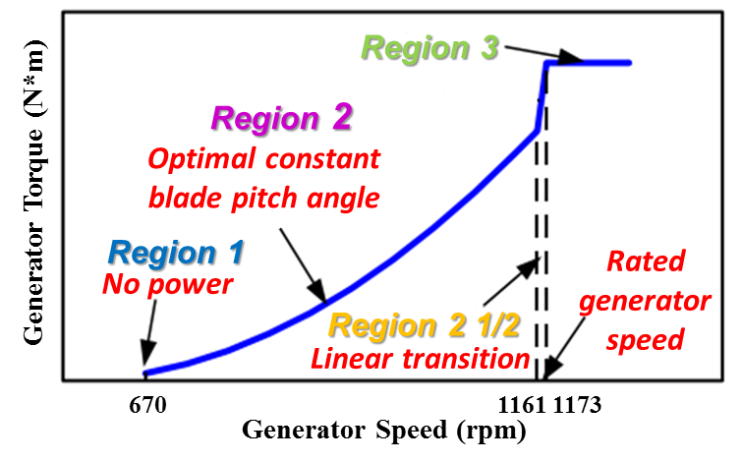
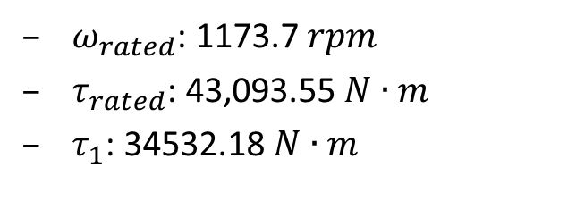
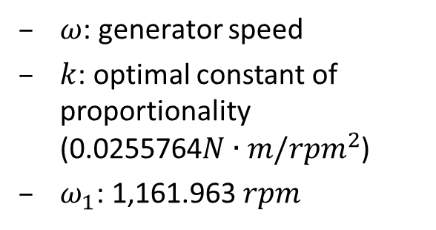
Standard Torque Control
Generator torque controller^{[1]}
$ω$: generator speed
$k$: optimal constant of proportionality (0.0255764$N∙m/{rpm}^{2}$)
$ω_{1}$: 1,161.963 $rpm$
$ω_{rated}$: 1173.7 $rpm$
$τ_{rated}$: 43,093.55 $N∙m$
$τ_{1}$: 34532.18 $N∙m$
[1] Jonkman et al., National Renewable Energy Laboratory Technical Report, 2009.
Notes:
Next we will introduce the standard torque control which proposed by Jonkman from NREL
In Region 1, torque is 0.
In region 2 ,torque is a function of generator speed. To maintain a constant optimal tip speed ratio
In region 2 and a half, it is a ……
In region 3 ,the torque is held at rated value

Slide 13
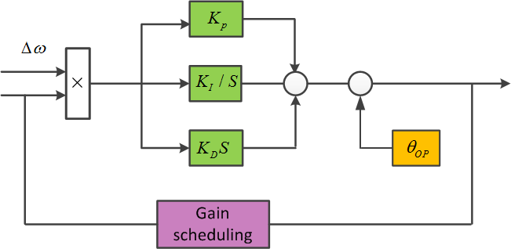
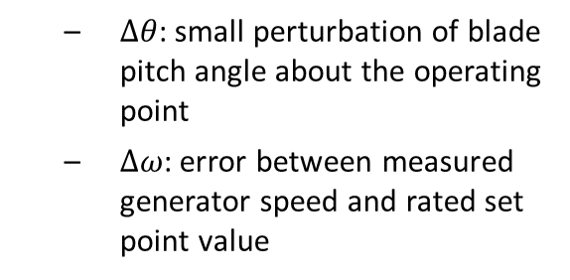
Baseline Pitch Control
Baseline Gain Scheduling Proportional Integral Derivative pitch controller ^{[1]}
$∆θ$: small perturbation of blade pitch angle about the operating point
$∆ω$: error between measured generator speed and rated set point value
Gain scheduling factor to accommodate time-varying operating wind condition
$θ_{k}$: blade pitch angle at which the pitch sensitivity is doubled from its value at the rated operating point.
Gain scheduling: $K_{p }{,K}_{I}$, $K_{D}$ are changed
[1] Jonkman et al., National Renewable Energy Laboratory Technical Report, 2009.
.
Notes:
Now let’s move to the baseline pitch control, it is a gain…..
Different from the classical PID control, we add a gain scheduling factor GK to ….
Since PID gains are tuned at Op, it can not gurantee the perfect performance at time-varying wind field.
After adding this factor, the gains can be changed when wind speed is varying.
(Pitch actuator: 30HZ)

Slide 14
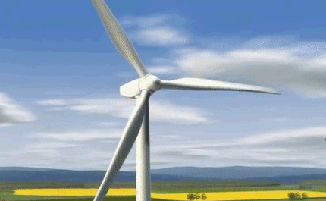
Adaptive Controller
Challenges for wind turbine systems:
Complex dynamics
Uncertain environments
Objective:
Generator speed at rated value and reduce oscillation
Mitigate loads
Near-term performance(constant speed)
Long-term reliability (less failure)
Source: Liebherr
Difficulties in designing controller:
System parameters not completely known
inherent model nonlinearities
unmodeled modes
manufacturing and assemblage tolerances
external operating uncertainties
Adaptive Controller
Notes:
Here comes our proposed adaptive controller, challenges…. Complx…and uncertain….
The large flexible structure operate in uncertain enviroments may have a lot unexpected failure
So the objective….
But there are diffculties to design such a contro….
We can not com….know sytem…due to..

Slide 15
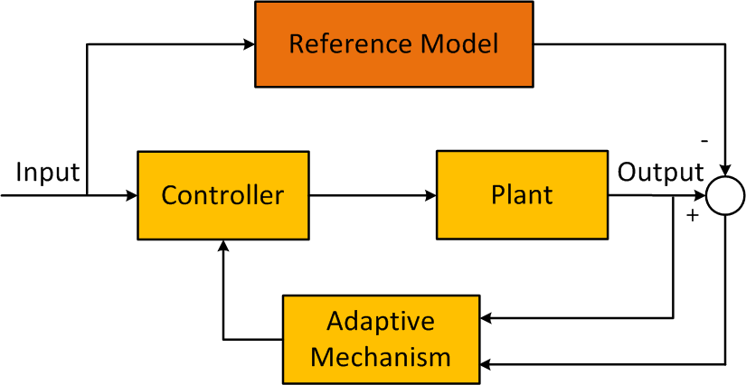

Adaptive Controller
Model reference adaptive control (MRAC)^{[2]}
[2] Åström, K.J. and Wittenmark, B., Adaptive control, 2013.
Potential advantages when applied to wind turbines:
Control law can adapt itself to external changing wind conditions
No need to know plant internal structure, order, critical parameter values
Eliminate the needs for explicitly identifying the large number of modes of wind turbine structure
How is this control strategy tailored for complex wind turbine dynamics
Notes:
Here is ……..
We use the error between reference model output and plant output to design the adjustment mechanism, the controller can adapt itself to uncertainties.
there are some potential advantages when this MRAC scheme applied..
On the top model reference adaptive control

Slide 16
Adaptive Controller
Method:
Model reference adaptive control (MRAC) with a disturbance accommodation controller (DAC): Two-layer structure
Control layer 1: DAC layer (closed-loop DAC: reference model)
disturbance accommodation
optimal trade-off between power capture and load mitigation
Control layer 2: Adaptive control layer
adapt to internal and external uncertainties
Layer 1
Layer 2
Notes:
This is our new attempt to tackle the problem…We adopt model…This is a two-layer..
The ..layer 1 is a …..We choose …as…The function of DAC is to achieve…
The disadvantage is that control performance can not be guaranteed when the turbine is not working near selected operating point.
So We will control layer 2 …to…
Next we will go through the details in layer 1 and layer 2

Slide 17
Control Layer 1: DAC layer
Reference model formulation with disturbance accommodation
Layer 1
Disturbance Accommodating Control ^{[2]}
Persistent wind disturbance input
unknown amplitude known waveform
step disturbance
Linearized model
Control law
[2] Wright, A.D., National Renewable Energy Laboratory Technical Report, 2004.
Notes:
In the control layer 1, we want our reference model to achieve distur… that is why we use DAC. In DAC…
The persistenet…
To design the clsed—DAC, we use a lin…to represent..
The control law consists of two parts, one is a feedback of state vriable, the other is a feedback of disturabce..
Substitute the control law…

Slide 18
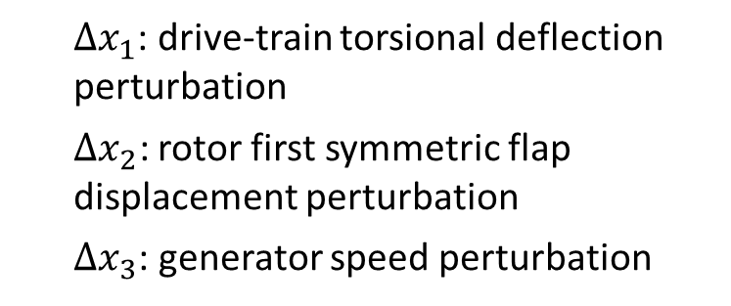
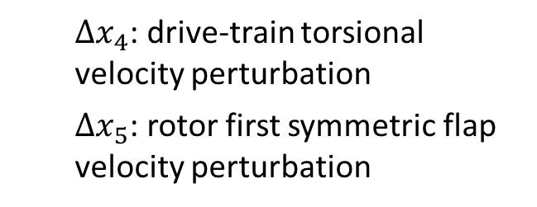
Disturbance Accommodating Control
Generator speed regulation & load mitigation
Disturbance rejection
Disturbance rejection
Linear Quadratic Regulator (LQR) for speed regulation and load mitigation
find the linear feedback gain G to minimize the quadratic cost function
${∆x}_{1}$: drive-train torsional deflection perturbation
${∆x}_{2}\text{:}$rotor first symmetric flap displacement perturbation
${∆x}_{3}$: generator speed perturbation
${∆x}_{4}$: drive-train torsional velocity perturbation
${∆x}_{5}$: rotor first symmetric flap velocity perturbation
Notes:
The first part is related with, the second …
Let’s begin with the first goal…. We will use LQR to find…..G. that is minimzing….This process corresponds to LQR block in Layer 1.
The function consists of the response vector and control input with the weighting ... The response vector includes the component deflections. Minimizing them can minimize loads they produce. The control input is related with the actuator life which we wan to prolong. So A trade-off between different response vector, and also with control efforts is meanigful.

Slide 19
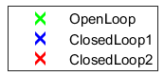
Performance Trade Off
Reference model with desired response
Stability and time-domain performance: the location of poles
Choose Q & R by trial and error: desired damping and transient response
Optimal trade-off between speed regulation and flapwise displacement response
Gen mode
Flap mode
Notes:
So we need to make a trade-off between different performances to obtain a diresed
The stability and time domain performance of the closed loop feedback system are dertermined by the location of poles.
Then We choose weights Q an R by trial and error, to obtain desired damping and transient respone
Sometimes, the improve…..Let us look at one example,the green ones are open-loop poles.
They are lose to ima…..To improve performance, we wish to move them to the left plane.
In case 1 , shown by blue, the flap mode pole has .9 dampling ratio, but gen mode pole is worse than green one.
In case, shoen by red, the flap mode pole has smaller damping ratip , but gen mode pole is better.
In this way, we can obtain optimal trade-off…
For one DOF model, calculate pole, then add one DOF, we can have another pole, then we can find poles corepoosnidng to mode.

Slide 20

Disturbance Accommodation
Generator speed regulation & load mitigation
Disturbance rejection
Disturbance accommodation (Choice of $G_{d}$)
Mitigate the effects of disturbance
Matrix does not have full rank and ill-conditioned
minimize the $L_{2}$ norm
Notes:
Next step is distubance accomation through second part, that is how to choose gain Gd, just make the coefficent tozero

Slide 21
Full State Estimator
Control input using state estimation
The only available response measurement is generator speed
Other states need to be estimated
Plant state and output estimator
Disturbance state estimator
Place the estimator pole to calculate $K_{x}, K_{D}$to make sure the estimator is stable and good transient characteristics
Notes:
So we have designded gain G and Gd ,Except that, The feedback controller also need information of state variabel and dis… which is missing
As the only….. ,

Slide 22
Control Layer 2: Adaptive Approach
Limitations of DAC
Not designed to be robust
May sensitive to errors in the turbine model
Adaptive control
Consider uncertainties: varying wind speed, unmodeled dynamics, and nonlinear aerodynamic loads
Theoretical assumption:
Actual wind turbine: linear, time-invariant, finite dimensional plant
Adaptive control law
Layer 2
Notes:
Next we will introduce the layer 2, the adaptive approach. The reason we add this layer at the top of DAC is the limitationd of DAC under internal and external uncertaines. . Robust to the time-varying wind speed. It also may..
The adaptive control can perfectly deal with these uncertainties. We use the closed-loop output of DAC as our reference signal and The nonlinear tuebine output as our plant output. The error between them is fed into the adaptive updating scheme. It consists of the error, state variable, control input and distruabnce. The on-line updating of gains can help deal with the uncertaities.

Slide 23
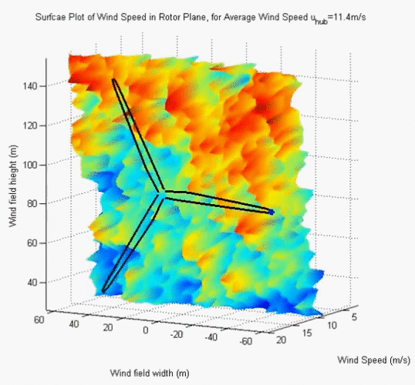
Case Study: Nonlinear Plant
Case study:
Test wind turbine
NREL offshore 5-MW baseline
wind turbine
Degree of freedom (DOF)
16 DOFs*
Turbulent wind field
Simulation time
Run time: 0 to 600 s
Integration step size: 0.0125 s
Blade pitch limit and pitch rate limit ^{[1]}
Minimum/maximum blade pitch: 0 degree / 90 degree
Maximum absolute blade pitch rate: 8 degree/s
[1] Jonkman et al., National Renewable Energy Laboratory Technical Report, 2009.
*First flapwise blade mode (3 blades), second flapwise blade mode (3 blades), first edgewise blade mode (3 blades), drivetrain rotational-flexibility, generator, yaw, first fore-aft tower bending-mode, second fore-aft tower bending-mode, first side-to-side tower bending-mode, second side-to-side tower bending-mode.
Notes:
The wind speed on each segment of blade is going to change with time.

Slide 24
Case Study: Results
Case 1: Mean wind speed 15 m/s
The flapwise moment of GSPI from 360 s to 480 s is much higher compared to DAC and adaptive control
Flapwise moment: 9% reduce
Max flap moment: 11% reduce
Notes:
The mean wind speed of turbu field is 15

Slide 25
Case Study: Results
Case 2: Mean wind speed 12 m/s
The overall trend of flapwise moment of GSPI is much higher than DAC and adaptive controller
Flapwise moment: 38% reduce
Max flap moment: 9% reduce

Slide 26
Case Study: Results
Case 3: Mean wind speed 17 m/s
Generator speed regulation: GSPI is the best, adaptive controller is better compared to DAC
Flapwise moment: nearly same
Max flap moment: 5% reduce

Slide 27
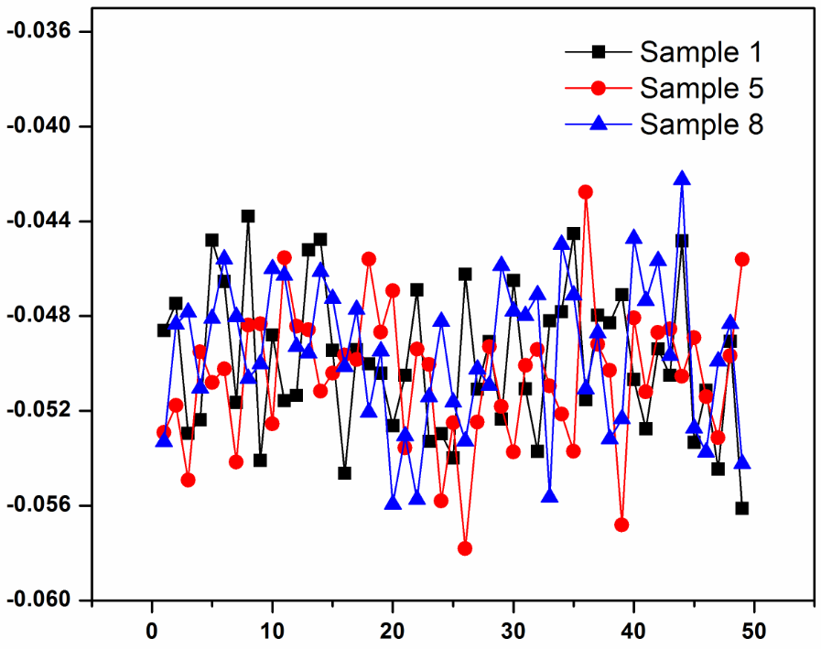
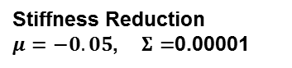
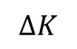
Performance under Structural Uncertainties
Stiffness uncertainties
Degradation due to rain/wind
The blade is divided to 49 different elements:
Stiffness reduction vector satisfies multivariate Gaussian distribution
20 samples of stiffness uncertainties
$$∆K$$
Stiffness Reduction
$μ=−0.05$, $Σ=$0.00001
Notes:
Next we’ll study the controller’s performance under structural uncertainties
As we all know, rain and wind may cause blade damage.
The blade is divided to 49 elements which have their own stiffness value.
for each blade element, the stiffness damage is usually not the same. Assume the stiffness reduction vector satisfies multivariate Gaussian distribution.
the mean value of stiffness uncertainty is 5%.
10 to -5
100 to 49
N to 49 100 to N

Slide 28
Performance under Structural Uncertainties
Results
Flap DEL (damage equivalent load) :
12 m/s 21%-23% reduce
15 m/s 20%-28% reduce
17 m/s 21%-31% reduce
Generator speed RMS error:
Adaptive control is better than DAC, worse than GSPI
Discussion:
Larger load reduction: GSPI, no consideration of model uncertainties
Speed regulation: GSPI only for speed regulation, no efforts on others
Adaptive: speed regulation & load mitigation
Notes:
Here are the results under sturactual uncertainties.
No consida…
The reason that load reduction is more than healthy condition is that
So the load reduction here is better than the health situation
So overall,adaptive control can have a gppd trade off

Slide 29
Outline
Background
Research Objective
Proposed Adaptive Control Method
Concluding Remarks
Future Tasks
Notes:
This is an outline of my presentation, first, background

Slide 30
Concluding Remarks
An adaptive control with disturbance/load mitigation capability is developed;
Load mitigation performances of adaptive control and DAC are comparable, and better than GSPI;
While GSPI shows the best performance in terms of generator speed regulation, adaptive control performs better than DAC in this regard;
When structural uncertainties exist, GSPI is sensitive to model uncertainties, and the adaptive control can deal with such uncertainties.
Notes:
Finally we have the conclusions,
I formulated an adaptive
New approach has comparable conclusions……..

Slide 31
Outline
Background
Research Objective
Proposed Adaptive Control Method
Concluding Remarks
Future Tasks
Notes:
This is an outline of my presentation, first, background

Slide 32

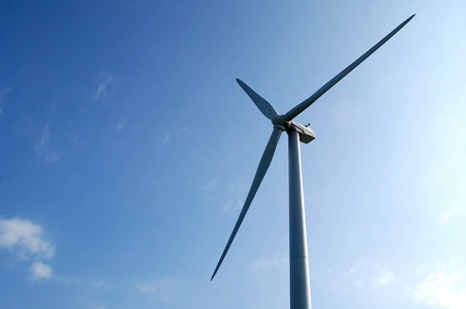
Future Work Plan - Task 1
Disturbance observer based control
High precision motion control
Micronano manufacturing
Advantage: great disturbance rejection performance
Promising to make improvements in wind turbine control area
Objective: speed and power control, load mitigation at some components
How is this control strategy tailored for complex wind turbine dynamics
Notes:
The utre 1……is DOB…this another good way to address speed and power control for the wind turbine..
It is actually the latest progress in high precision motion control. So far, it has been applied successfully to micronano manufacturing. But……It is highly promising to make fundamental improvement in the turbine blade control
Actualy Our preliminary result shows DOB is capable of regulating speed and power. Which is the first sucefful example of using DOB controller of wind turbine.
Let us see…
Height:10nm width 100nm
Next we will explain why this DOB controller can help

Slide 33
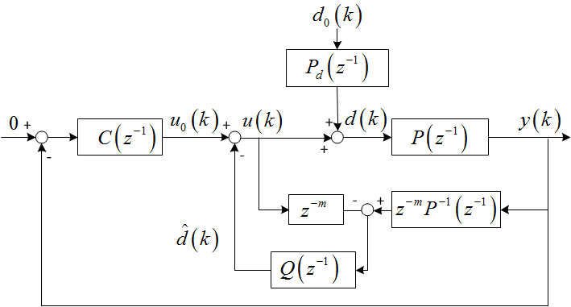
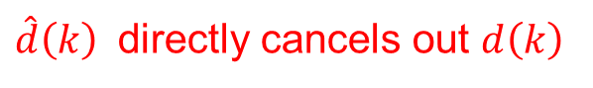
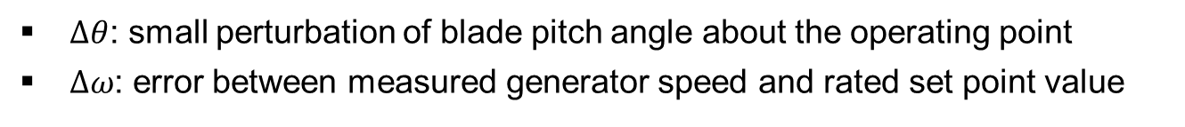
Disturbance Observer Based Controller
$d_{0}\left(k\right)$:
wind disturbance
$P_{d}\left(z^{−1}\right)$:
disturbance model
$P\left(z^{−1}\right)$:
plant model
$P^{−1}\left(z^{−1}\right)$:
model inversion
$Q\left(z^{−1}\right)$:
filter
$C\left(z^{−1}\right)$:
PID controller
Why this controller?
Gain-scheduling PID: perfect gain correction is not strictly guaranteed
Augmented controller: inner-loop can further reject low frequency disturbance based on the disturbance suppression of the outer-loop.
den
num
$\hat{d}\left(k\right)$ directly cancels out $d\left(k\right)$
0
filter Q
Notes:
Here we quickly go through the essential details
It is an inverse-based disturbance cancelation scheme. We want to use d hat to directly cancel out d
The inner loop is the disturbance observer structure, the outter loop is the gain-scheduled PID controller. Both of them will contribute to disturbance rejection.
The P inverse should be stable
The fundamental idea is to make the differnec eto be 0
Through the equations, we can derive filter Q
For any signal d0 it will satisfy this eq. where Bd is numerator of z transofrm of d0. Ad is the corsponding den.

Slide 34
5-DOF Linearized Model (Preliminary Result)
5 DOF: Generator DOF, drivetrain torsional flexiblity DOF, and first flapwise blade mode DOF (three blades)
Further analysis is needed to deal with the nonlinearities
Notes:
To obtain the preliminary result of the DOB controller, we first apply the controller into the 5-DOF linearized model
These are the
The result seems to be promising, so how is it with the nonlinear plant

Slide 35
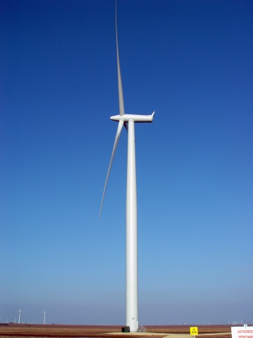
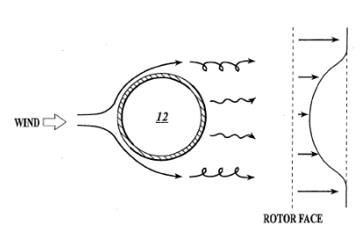
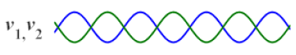
Future Work Plan - Task 2
Individual pitch control to mitigate periodic loads
Enabled by hardware improvements
Asymmetrical loads: caused by wind shear and tower shadow effects
Tower shadow
Wind shear
wind
wind
upwind turbine
downwind turbine
Tower top
Notes:
In our previous study, we only use collective pitch control to acheive load mitigation. All blades pitch at the same angle. So only the Symmetricl loads can be reduced. But, in practical wind turbine applications, periodic loads are inevitable that need our attention.
The concept of tower shadow is illustrated in these two figures.
there is a significant difference between these situations.
In the left figure, the wind passes through blade first and then tower.
In the right figure, the wind passes through tower first and then blade. If we see from the tower top, the wind speed is decresed due to the shadow of tower in the right figure.
Wind shear means the wind speeds at different heights are different, when a blade is rotating at a plane, it actually receives the harmonic force from wind.
Therefore, the peordic loads are produced to influence the turbines.

Slide 36
Future Work Plan-Task 2
Collective loop:
GSPI/DOB
Speed and power regulation
Individual loop:
H infinity control with weighting function selection
Periodic load mitigation
Analysis ongoing
Notes:
We plan to use individual control to tracle this problem. The upper control loop is the collective loop, the lower loop is the individual loop.

Slide 37
The End
Questions?
Notes:
Thank you

Slide 38
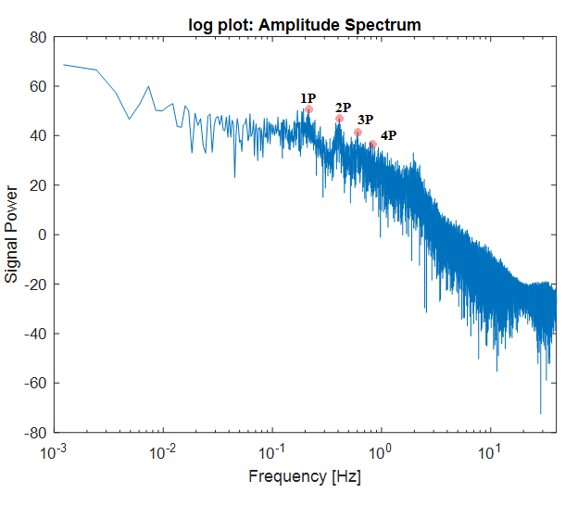
Future Task 2 Preliminary Results
GSPI collective + PI individual
 | 1P | 2P | 3P | 4P
GSPI collective | 64.99(dB) | 46.53 | 41.86 | 37.05
GSPI collective + PI individual | 46.46 | 45.1 | 41.47 | 33.16
GSPI collective + Hinf individual | 38.22 | 32.46 | 41.97 | 29.91

Slide 39
Table 1. Normalized performance comparison in 3 cases.
Wind speed | Performance | GSPI | DAC | Adaptive
15 (Case 1) | pitch rate RMS error | 1 | 0.7982 | 0.6980
 | tower fore-aft DEL | 1 | 0.6224 | 0.6224
 | low speed shaft DEL | 1 | 1.1212 | 1.1212
12 (Case 2) | pitch rate RMS error | 1 | 0.6983 | 0.6637
 | tower fore-aft DEL | 1 | 0.3234 | 0.3234
 | low speed shaft DEL | 1 | 1.0292 | 1.0292
17 (Case 3) | pitch rate RMS error | 1 | 0.7908 | 0.6717
 | tower fore-aft DEL | 1 | 0.7686 | 0.7686
 | low speed shaft DEL | 1 | 0.7751 | 0.7751

Slide 40
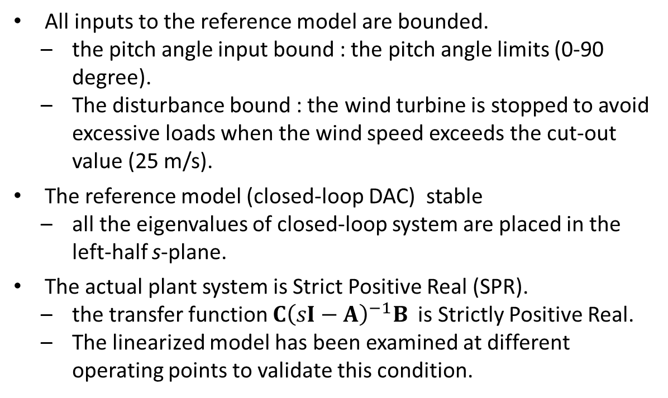
Stability analysis
All inputs to the reference model are bounded.
the pitch angle input bound : the pitch angle limits (0-90 degree).
The disturbance bound : the wind turbine is stopped to avoid excessive loads when the wind speed exceeds the cut-out value (25 m/s).
The reference model (closed-loop DAC) stable
all the eigenvalues of closed-loop system are placed in the left-half s-plane.
The actual plant system is Strict Positive Real (SPR).
the transfer function ${C\left(sI−A\right)}^{−1}B$ is Strictly Positive Real.
The linearized model has been examined at different operating points to validate this condition.
[3] Frost, S.A., Balas, M.J., and Wright, A.D., International Journal of Robust and Nonlinear Control, 2009.
Notes:
The stability of whole system is guranteed by the following conditions

Slide 41
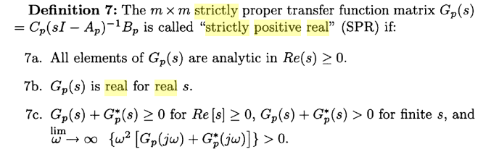
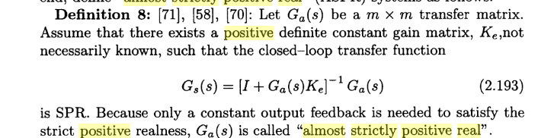

Slide 42
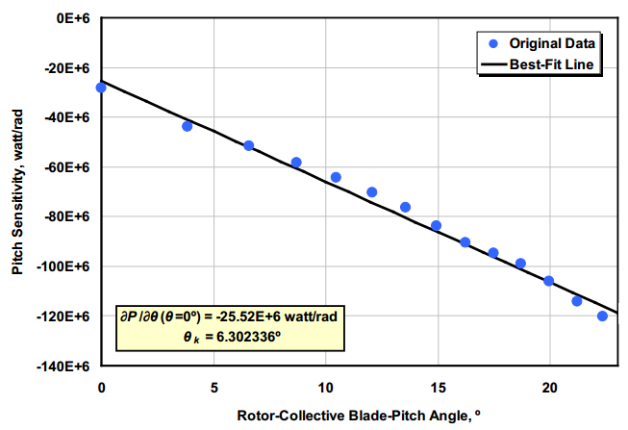
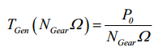
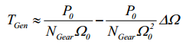
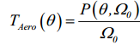
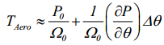
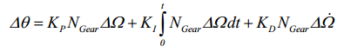
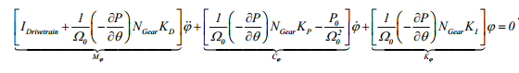
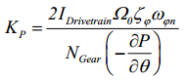
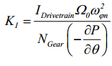
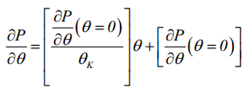
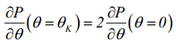
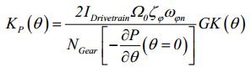


Gain Scheduling PID
$P_{0}$: rated power
$P$: power

Slide 43

Region 2 Torque Control

Slide 44


Simple Model
Aerodynamic torque
$T_{a}$: aerodynamic torque
$C_{p}$: power efficiency
: tip speed ratio
$ρ$: air intensity
$v$ : wind speed
$ω_{r}$ : rotor speed
$ω_{g}$ :generator speed
$T_{ls}:$ low speed shaft torque
$T_{hs}:$ high speed shaft torque
$T_{em}:$ generator electromagnetic torque
$J_{r}$ : rotor inertia
$J_{g}$ : generator inertia
$J_{t}$ : turbine total inertia
$K_{r}$ : rotor external damping
$K_{g}$ : generator external damping
$K_{t}$ : turbine total external damping
Rotor Dynamics and
generator dynamics
Gearbox ratio
Notes:
In most of the literature, a simple model is adopted to design adaptive torque control and sliding model control in order to get better speed regulation.
The aerodynamics… is a function of power efficiency, wind speed and rotor speed, it is highly nonlinear.
Assume the low speed shaft is rigid, the rotor dynamics and generator dynamics can be expressed as…
As the low speed shaft torque and HSS torque satisfy gearbox ratio relationship, finally we could get a simple equation of motion.
We can control the electromagnetic torque to track the generator speed.

Slide 45



Region 2 Standard Torque Control
TSR:$λ=\frac{ωR}{v}$
Generator Torque (N*m)
Region 3
Region 2 standard torque control
Region 2
Optimal constant blade pitch angle
Region 1
Rated generator speed
No power
Region 2 1/2
Linear transition
670
1161
1173
Generator Speed (rpm)
Notes:
In Region 2, the control objective is to maximize the power capture. We use torque control to achieve it. Let us look at the Cp surface. We can see the maximum value is in pitch angle 0 tip speed ratio 7.5.
That is make the tip speed ratio be the optimal value, at the optimal pitch angle.
Then we should let the rotor speed track the wind speed. Here the pitch control is disabled, then we control torque to change rotor speed.
power Per second

Slide 46







Region 2 standard torque control
$$λ=\frac{ωR}{v}$$
How does it drive Region 2 to obtain maximum $C_{p}$ (Assume uniform constant wind)
$β=0$, ${λ }_{∗}$=7.5
The curve (dotted line)
The solid line $Cp(β=0)$
$λ>{λ }_{∗}$, $\dot{ω_{r}}<0$, rotor will decelerate towards $λ={λ }_{∗}$
$C_{p}≤$ $C_{pmax}$
, , $\dot{ω_{r}>}0\text{, }λ{<λ }_{∗}$, it will accelerate to ${λ }_{∗}$
, $\dot{ω_{r}<}0$ rotor speed will slow to zero

Slide 47








Pitch angle
Low speed shaft horizontal axis
rotor plane
Wind turbine starts($β=0$)
Wind turbine stops($β=$90)
Notes:
Pitch angle is the angle between chord line and rotor plane

Slide 48


Flapwise shear force and moment
Flapwise shear force at the blade root:
Directed along the $x_{b,i}$ axis (kN)
Flapwise moment at the blade root :
About the $y_{b,i}$ axis (kN*m)
Wind
Notes:
Perpendicular
parallel

Slide 49

Pitch Sensitivity
Blade-pitch sensitivity
aerodynamic property of the rotor that depends on the wind speed, rotor speed, and blade-pitch angle
perturb the rotor collective blade pitch angle at each operating point and measure the resulting variation in aerodynamic power
Table Sensitivity of Aerodynamic Power to Blade Pitch in Region 3
Wind speed (m/s) | Rotor Speed (rpm) | Pitch Angle (deg) | $\frac{∂θ}{∂x}$ (watt/rad)
11.4-Rated | 12.1 | 0.00 | -28.24E+6
12.0 | 12.1 | 3.83 | -43.73E+6
13.0 | 12.1 | 6.60 | -51.66E+6
14.0 | 12.1 | 8.70 | -58.44E+6
15.0 | 12.1 | 10.45 | -64.44E+6
16.0 | 12.1 | 12.06 | -70.46E+6
17.0 | 12.1 | 13.54 | -76.53E+6
18.0 | 12.1 | 14.92 | -83.94E+6
19.0 | 12.1 | 16.23 | -90.71E+6
20.0 | 12.1 | 17.47 | -94.71E+6
21.0 | 12.1 | 18.70 | -99.04E+6
22.0 | 12.1 | 19.94 | -105.90E+6
23.0 | 12.1 | 21.18 | -114.30E+6
24.0 | 12.1 | 22.35 | -120.20E+6
25.0 | 12.1 | 23.47 | -125.30E+6

Slide 50

Torque control: Choose the appropriate stator current according to the difference of reference torque and actual torque
Control structure of a permanent magnet synchronous generator system for use in wind turbines
Notes:
Stator coils
Rotor magnet

Slide 51


Slide 52



x* ideal trajectory
Lyapunov stability
[5] Frost, S.A., Balas, M.J., and Wright, A.D., 2009, “Direct adaptive control of a utility-scale wind turbine for speed regulation,” International Journal of Robust and Nonlinear Control, V19 (1), pp. 59-71.

Slide 53
TurbSim
TurbSim Input File. Valid for TurbSim v1.50; 17-May-2010; Example file that can be used with simulations for the NREL 5MW Baseline Turbine
---------Runtime Options-----------------------------------
511347 RandSeed1 - First random seed (-2147483648 to 2147483647)
RanLux RandSeed2 - Second random seed (-2147483648 to 2147483647) for intrinsic pRNG, or an alternative pRNG RanLux or RNSNLW
False WrBHHTP - Output hub-height turbulence parameters in binary form (Generates RootName.bin)
False WrFHHTP - Output hub-height turbulence parameters in formatted form (Generates RootName.dat)
False WrADHH - Output hub-height time-series data in AeroDyn form (Generates RootName.hh)
False WrADFF - Output full-field time-series data in TurbSimAeroDyn form (Generates RootName.bts)
True WrBLFF - Output full-field time-series data in BLADEDAeroDyn form (Generates RootName.wnd)
False WrADTWR - Output tower time-series data (Generates RootName.twr)
False WrFMTFF - Output full-field time-series data in formatted (readable) form (Generates RootName.u, RootName.v, RootName.w)
False WrACT - Output coherent turbulence time steps in AeroDyn form (Generates RootName.cts)
True Clockwise - Clockwise rotation looking downwind (used only for full-field binary files - not necessary for AeroDyn)
0 ScaleIEC - Scale IEC turbulence models to exact target standard deviation [0=no additional scaling; 1=use hub scale uniformly; 2=use individual scales]
--------TurbineModel Specifications-----------------------
31 NumGrid_Z - Vertical grid-point matrix dimension
31 NumGrid_Y - Horizontal grid-point matrix dimension
0.05 TimeStep - Time step [seconds]
630.0 AnalysisTime - Length of analysis time series [seconds]
630.0 UsableTime - Usable length of output time series [seconds] (program will add GridWidthMeanHHWS seconds)
90.0 HubHt - Hub height [m] (should be 0.5GridHeight)
145.0 GridHeight - Grid height [m]
145.0 GridWidth - Grid width [m] (should be = 2(RotorRadius+ShaftLength))
0 VFlowAng - Vertical mean flow (uptilt) angle [degrees]
0 HFlowAng - Horizontal mean flow (skew) angle [degrees]
--------Meteorological Boundary Conditions-------------------
IECKAI TurbModel - Turbulence model (IECKAI=Kaimal, IECVKM=von Karman, GP_LLJ, NWTCUP, SMOOTH, WF_UPW, WF_07D, WF_14D, or NONE)
1-ed3 IECstandard - Number of IEC 61400-x standard (x=1,2, or 3 with optional 61400-1 edition number (i.e. 1-Ed2) )
B IECturbc - IEC turbulence characteristic (A, B, C or the turbulence intensity in percent) (KHTEST option with NWTCUP, not used for other models)
NTM IEC_WindType - IEC turbulence type (NTM=normal, xETM=extreme turbulence, xEWM1=extreme 1-year wind, xEWM50=extreme 50-year wind, where x=wind turbine class 1, 2, or 3)
default ETMc - IEC Extreme turbulence model c parameter [ms]
PL WindProfileType - Wind profile type (JET=Low-level jet,LOG=Logarithmic,PL=Power law, or default, or USR=User-defined)
90.0 RefHt - Height of the reference wind speed [m]
18.0 URef - Mean (total) wind speed at the reference height [ms]
default ZJetMax - Jet height [m] (used only for JET wind profile, valid 70-490 m)
default PLExp - Power law exponent [-] (or default)
default Z0 - Surface roughness length [m] (or default)
--------Non-IEC Meteorological Boundary Conditions------------
default Latitude - Site latitude [degrees] (or default)
0.05 RICH_NO - Gradient Richardson number
default UStar - Friction or shear velocity [ms] (or default)
default ZI - Mixing layer depth [m] (or default)
default PC_UW - Hub mean u'w' Reynolds stress [(ms)^2] (or default)
default PC_UV - Hub mean u'v' Reynolds stress [(ms)^2] (or default)
default PC_VW - Hub mean v'w' Reynolds stress [(ms)^2] (or default)
default IncDec1 - u-component coherence parameters (e.g. 10.0 0.3e-3 in quotes) (or default)
default IncDec2 - v-component coherence parameters (e.g. 10.0 0.3e-3 in quotes) (or default)
default IncDec3 - w-component coherence parameters (e.g. 10.0 0.3e-3 in quotes) (or default)
default CohExp - Coherence exponent (or default)
--------Coherent Turbulence Scaling Parameters-------------------
"F:\Wind Turbine\TurbSim\Test\Eventdata" - Name of the path where event data files are located
Random CTEventFile - Type of event files (random, les or dns)
true Randomize - Randomize disturbance scale and location (truefalse)
1.0 DistScl - Disturbance scale (ratio of dataset height to rotor disk).
0.5 CTLy - Fractional location of tower centerline from right (looking downwind) to left side of the dataset.
0.5 CTLz - Fractional location of hub height from the bottom of the dataset.
10.0 CTStartTime - Minimum start time for coherent structures in RootName.cts [seconds]
==================================================
NOTE Do not add or remove any lines in this file!
==================================================

